Slide 1
Mlaas - Secure Multi-party computation
Souhail MEFTAH & Ruomu HOU

Slide 2
Outline
Background and Motivation
Problem Definition
Functional Requirements
Secure Multi-Party Computation
Our Model
Resuls

Slide 3
Background and Motivation
MLaaS: Model parameters is a business asset; Data is personal and tightly regulated
One possible solution: Encrypt both the model and data and to train over the encrypted values
SMPC / FHE / SHE / FE

Slide 4
IDASH PRIVACY & SECURITY WORKSHOP 2019 – secure genome analysis competition
Problem Definition

Slide 5
Functional Requirements
Case Study: Genome data from human subjects
We need to allow two or more owners to build a joint ML using MPC/SMC
Display the efficiency of an MPC/SMC implementation achievable in building a machine learning model for supporting a secure collaboration
The meta-data, i.e. The number of features/records should be made public, as well as the final model
Any information that cannot be infered from that must not be leaked
Each computing node should not learn anything about the data

Slide 6
The DataSet: GSE2034 [3,4,5]
Gene expression data obtained from breast cancer patients
Obtained using the Affymetrix Human U133a GeneChips from frozen tumor samples
Contains the expression levels of 12,634 genes from 255 breast cancer samples, in which 142 are recurrent tumor samples (positive samples) and 83 samples are non-recurrence samples (negative samples)

Slide 7
Testing - Performance Metrics
Training Accuracy: How close it is comparing to the model built by the non-secure algorithm
Total running time: Should only run for up to 24h (according to IDASH guidelines)
Communication cost: The rounds and sizes of data exchange among computing nodes in the SMC

Slide 8
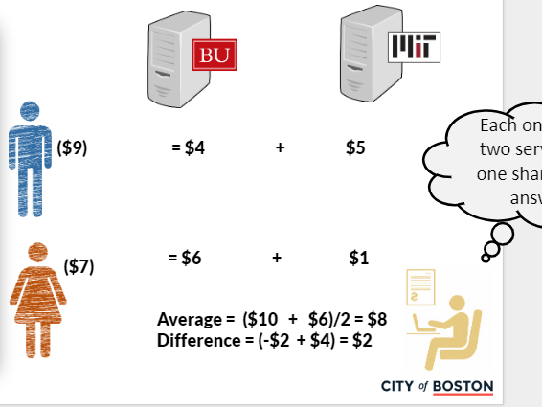
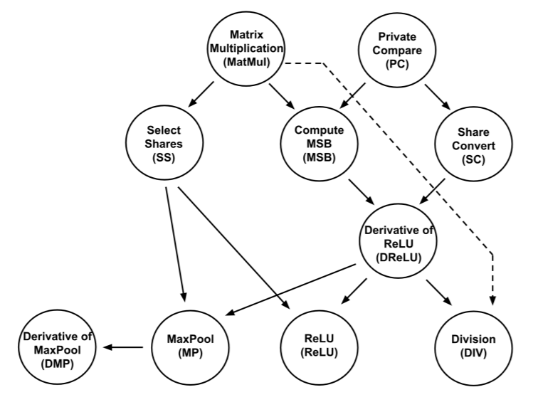
Our SMPC
Consists of private additive sharing
Relies on the crypto protocols SPDZ [1] and SecureNN [2]
Notes:
SPDZ denotes a multiparty computation scheme in the preprocessing model based on somewhat homomorphic encryption (SHE) in the form of BGV.

Slide 9
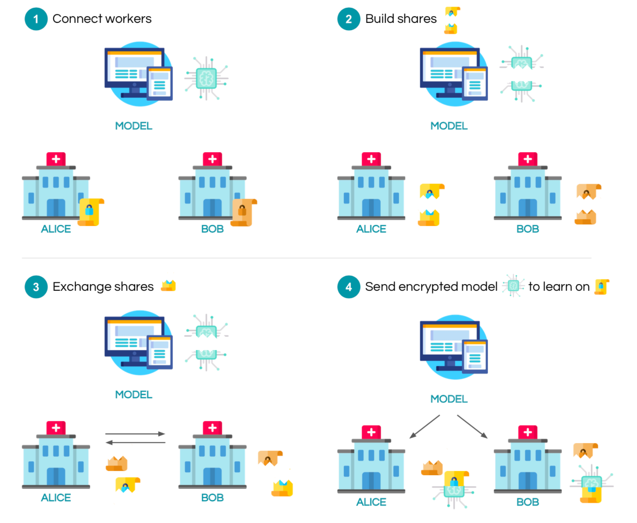
Our Setting
Notes:
The exact setting of our project is the following: consider that you are the server and you would like to train your model on some data held by workers. The server secret shares his model and send each share to a worker. The workers also secret share their data and exchange it between them. In the configuration that we will study, there are 2 workers: alice and bob. After exchanging shares, each of them now has one of their own shares, one share of the other worker, and one share of the model. Computation can now start to privately train the model using the appropriate crypto protocols. Once the model is trained, all the shares can be sent back to the server to decrypt it.

Slide 10



Our Code
Organized on Jupyter Notebook
Programmed using Pytorch
Leverages Opennmind’s Pysyft
Intel E5-2620V3, 256GB DDR3 RAM
Notes:
Our experiment runs on 1 machine on the Tembusu Cluster with Intel E5-2620V3, 256GB DDR3 RAM, and CentOS 7.x.x. The code has been tested on Ubuntu 18.04 as well.

Slide 11
Our Deep Learning Model
Grid Search
Loss Function: Binary Cross Entropy
Learing Rate: 0,001
Momentum: 0,9
Number of Batches: 100

Slide 12
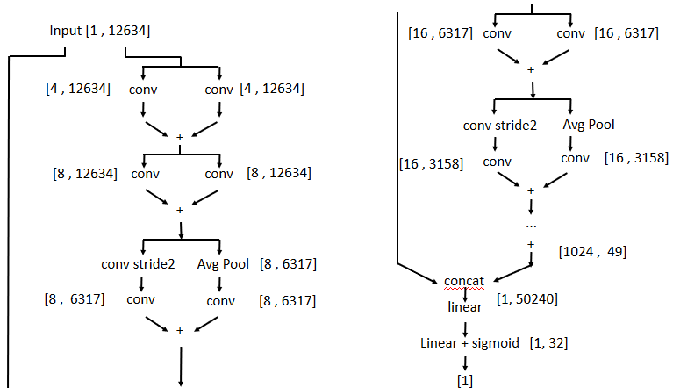
Our Deep Learning Model

Slide 13
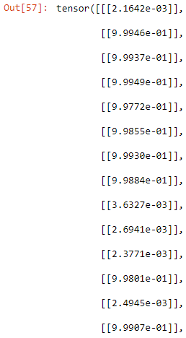
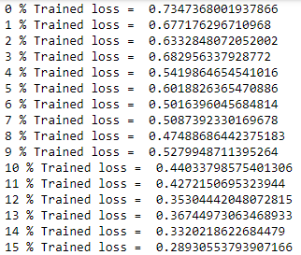
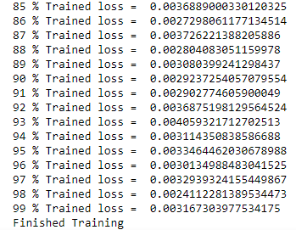
Results
…

Slide 14
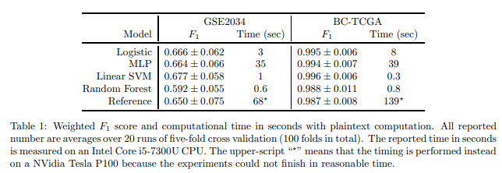
Results
[6]
1-Fold | 0,3s | 100-Fold | 12s

Slide 15
Limitations
ReLu and ReLu_Deriv require serializable workers
Currrently, only VirtualWorkers are Serializable; which means GridWorkers and WebsocketWorkers will not be able to run these operations
Mitigation:
Trade off some of the model’s accuracy by replacing ReLu activations in the model with approximations of the function

Slide 16
Conclusion

Slide 17
References
[1] Keller, M., Pastro, V., & Rotaru, D. (2018). Overdrive: Making SPDZ Great Again. Advances in Cryptology – EUROCRYPT 2018 Lecture Notes in Computer Science, 158–189. doi: 10.1007/978-3-319-78372-7_6
[2] Wagh, S., Gupta, D., & Chandran, N. (2019). SecureNN: 3-Party Secure Computation for Neural Network Training. Proceedings on Privacy Enhancing Technologies, 2019(3), 26–49. doi: 10.2478/popets-2019-0035
[3] Cancer Genome Atlas Network et al. Comprehensive molecular portraits ofhuman breast tumours.Nature, 490(7418):61, 2012.
[4] Haozhe Xie, Jie Li, Qiaosheng Zhang, and Yadong Wang. Comparisonamong dimensionality reduction techniques based on random projectionfor cancer classification.Computational biology and chemistry, 65:165–172,2016.
[5] Yixin Wang, Jan GM Klijn, Yi Zhang, Anieta M Sieuwerts, Maxime PLook, Fei Yang, Dmitri Talantov, Mieke Timmermans, Marion E Meijer-vanGelder, Jack Yu, et al. Gene-expression profiles to predict distant metastasis of lymph-node-negative primary breast cancer.The Lancet, 365(9460):671–679, 2005
[6] https://arxiv.org/abs/1910.11680v1

